Slide 1
CRIMSON REWARDS
ADULTING
DONE
RIGHT

Slide 2
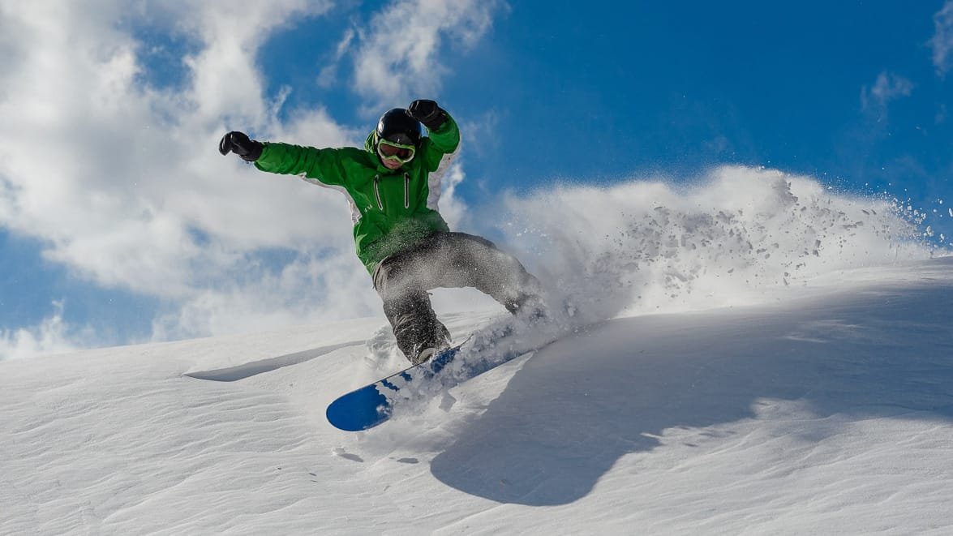
Notes:
Skiing – toilet paper
Golf - laundry
Road trip – moving
PHIL (MARTA CUT IN -)

Slide 3


Slide 4
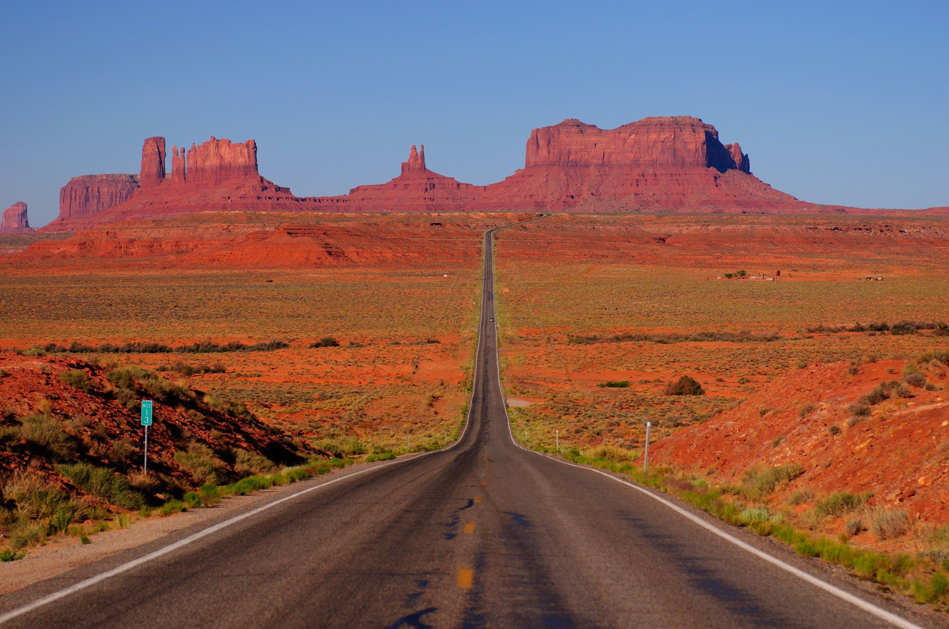

Slide 5
OVERVIEW
Ask
Develop a 6-week integrated marketing campaign to launch Crimson loyalty program targeting the Millennial market
1) Create awareness of the program
2) Encourage acquisition for Crimson loyalty and credit card sign-ups from the Millennial target market.
Notes:
PHIL
Develop a 6-week integrated marketing campaign to launch Crimson loyalty program targeting the Millennial market
1) Create awareness of the program
2) Encourage acquisition for Crimson loyalty and credit card sign-ups from the Millennial target market.

Slide 6


OVERVIEW
Problem
Notes:
Animation PHIL
Crimson’s flagship banner, Canadian Tire, is losing relevance with the Millennial segment because they are reaching key life (and purchase) milestones later than their parents.

Slide 7
OVERVIEW
Solution
ADULTING
Notes:
Animation PHIL
Make CRIMSON the loyalty program that REWARDS millennials for adulting and use it as a catalyst to drive CT’s top of mind awareness among millennials.

Slide 8
Insights
CRIMSON BENEFITS
= flexibility and control over rewards
Notes:
What is it about Crimson that everyone should be excited about.
Crimson offers the opportunity to have complete control in how you earn and spend
PHIL

Slide 9






Insights
Flagship banner, Canadian tire has greatest millennial reach among crimson retailers
Physical reach: 90% of Canadian live within 15 minutes of a Canadian Tire
Media reach:
M 13.1%
F 10.9%
M 4.7%
F 3.2%
M 1.4%
F 1.0%
M 0.4%
F 0.2%
M 0.1%
F 0.1%
M 0.1%
F0%
Notes:
PHIL
LARGEST RETAIL BANNER IN THE CANADIAN TIRE FAMILY OF COMPANIES
HAS LARGEST GEOGRAPHICAL REACH (90% OF CANADIAN LIVE WITHIN 15 MINUTES OF A CANADIAN TIRE)
OFFERS OPPORTUNITY FOR OVERALL UMBRELLA ROI
BROADEST MEDIA REACH – SEE COMM SCORE BELOW

Slide 10
Who are the millennials

Slide 11
Millennials – 1980-1999 (Marta born in 1988)
When Marta started school she was lucky to have 1 computer per 30 students, now every single person carries a
computer more powerful than the one that sent the first man to the moon in their back pocket. – 98% of millennial use smart devices
Marta graduated her undergrad in 2010, at the height of the great recession putting downward pressure on jobs and salaries and painting her world view. – Great recession has shaped millennial word views
Marta lives downtown and so do most of the people she graduated – 66% of millennials are urban
Let’s dig further

Slide 12

Insights
Millennials are redefining timelines
1975
18 YEARSOLD
24
YEARS OLD
24
YEARS OLD
30
YEARS OLD
23
YEARS OLD
29
YEARS OLD
30
YEARS OLD
36
YEARS OLD
2015
Notes:
MARTA
Halo
Characteristics
Who are the millennials
WHY THEY ARE NOT RESONATING
CONNECTION TO BRAND
CTC IS NOT DOING SOMETHING – WHAT IS MISSING!?!?!
HOW TO TALK TO GEN Z – LIVES THROUGH PHONE
NEW CONSUMER – MILLENNIAL - DIFFERENT LIFESTYLE – COMMICAL WAY
Top line data facts
10 points
Don’t own car
Meet 3 different people
Who they are
Kat is 25 – Toronto
Entry-lebel
Profiles that TELL STORY
- TELLING IN A COMPELLING WAY
OVERALL –
This slide will outline key demographics/psychographics such as
1 – specific age cohort
2 – urban
3 – use of social/technology

Slide 13
What has changed
Disrupting how you work
  Came of age during the global recession
  Rise of gig economy
  Autonomy _ Entrepreneurship 35%
How millennials buy
  Buy online
  Less brand loyal than their parents
  Savy, not frugal
  Spending on experiences
  2013 millennials had $1962 less in disposable income annually than their parents at their age
  Millennials are more likely than their parents to join loyalty programs (as long as they match their needs) and enjoy non-financial rewards
  Millennials are less brand loyal than their parents

Slide 14
insights
Demographics
Age
education
BASICS
SAVY CONSUMER
DIGITAL NATIVE
$30 000 student debt
8 second attention span
98% use smart devices
66% urban
35% entrepreneurs
70% post secondary
Late Millennials
1993 – 1999
19-25
Mid- Millennials
1987 – 1993
25 - 31
Early Millennials
1980 – 1986
32 - 38
Notes:
Comfortable with change more than any other generation – digital
Financial pressure – not frugal
Smart shoppers

Slide 15

Insights
Samantha
Savvy city shopper
She doesn’t shop at Canadian Tire because she associates it with owning a home with backyard.
Shopping Intent
Desire for Deal / Rewards
Shopping Research
Canadian Tire – Top of Mind Awareness
Notes:
Samantha is a 26 year old communications coordinator living in an apartment in Calgary with her boyfriend. She does most of the shopping for her household, and scans her Flipp app before shopping. She is not very brand loyal, and is willing to switch to save money. She is a member of 4 loyalty programs, but most active on PC Optimum to get savings on her groceries, and Air Miles because she is saving for a trip.
LIKELY TO BE PERSUADED BY A PROMO TO SHOP
WILL DO RESEARCH BEFORE GOING TO STORE
CHOOSES RETAILER TO VISIT BY LOYALTY POINTS
GET HER IN-STORE BY PROVIDING REWARDS AND PROMOTIONS

Slide 16
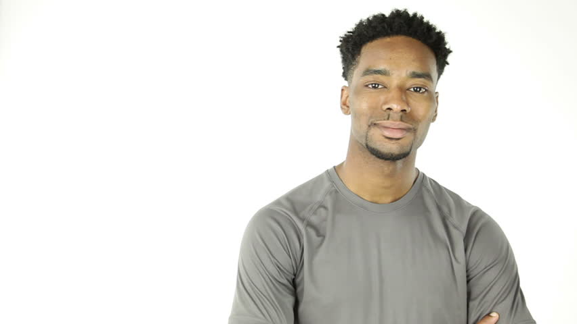
Insights
William
Will shops at CTC occasionally usually to buy hockey equipment for his beer league.
Shopping Intent
Desire for Deal / Rewards
Shopping Research
Canadian Tire – Top of Mind Awareness
Notes:
William is a 28 year old, single, financial analyst renting a condo in Toronto. He struggled to find a full-time position for the first few years after university, so is carrying a heavy debt load. He doesn’t like shopping at all, except when buying video games and the occasional case of beer. He doesn’t plan his shopping and only buys household items when he runs out. That said he loves a good deal.
LIKELY TO BUY SOMETHING BECAUSE HE RAN OUT
WILL NOT DO PROACTIVE RESEARCH, BUT MAY PULL INFO UP ON PHONE IN-STORE WHEN DECIDING BETWEEN PRODUCTS
CHOOSES RETAILER AND THEN LOOKS AT DEALS WHILE IN-STORE
MAKE CANADIAN TIRE ASSOCIATED WITH PLACES HE SHOPS – PUSH NOTIFICATIONS / TOP OF MIND AWARENESS

Slide 17

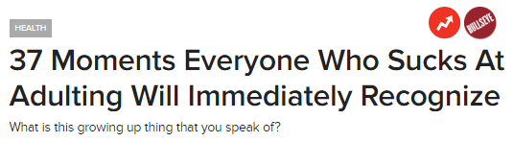
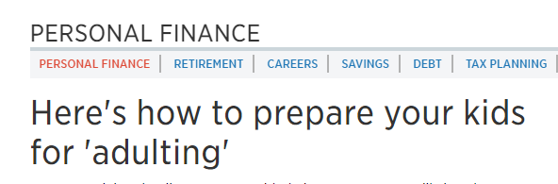
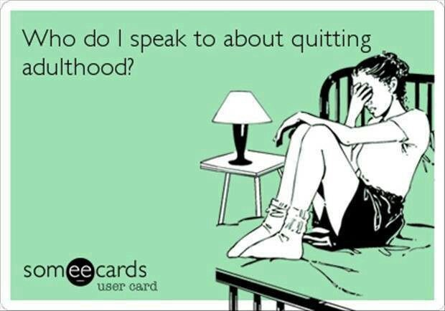
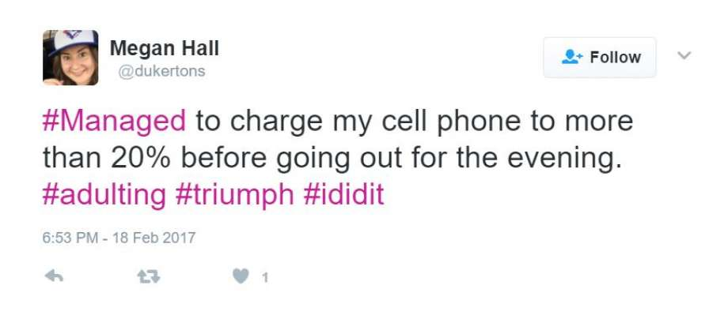

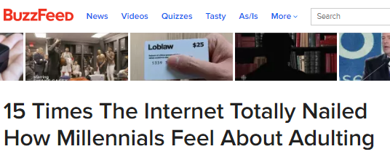
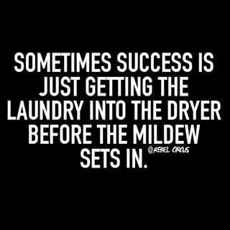
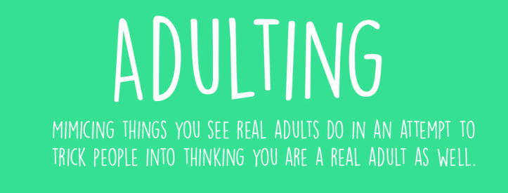
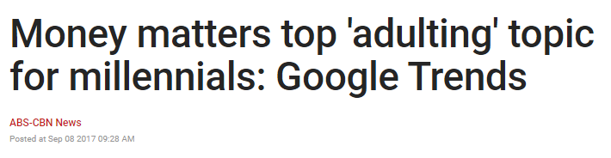
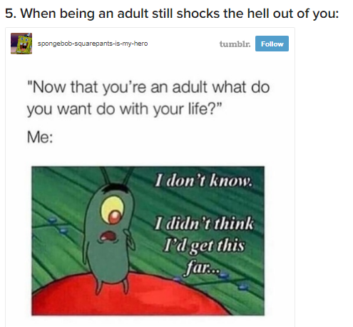
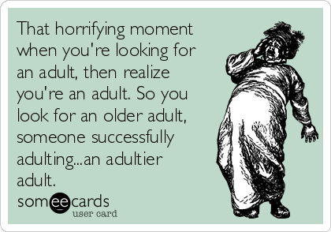
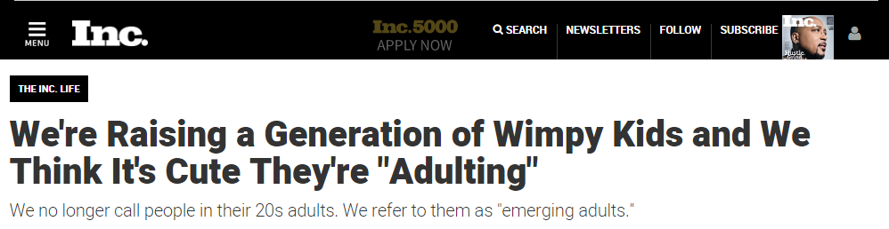

Slide 18
INSIGHTS
INTRODUCING THE ADULTING PHENOMENON
a•dult•ing
[ə də́lt ɪŋ]
Verb
The practice of behaving in a way characteristic of a responsible adult, especially the accomplishment of mundane but necessary tasks.
En jouant à l’adulte
Oui, j’ai des trous dans mes jeans, mais j’ai aussi payé mes impôts, donc je suis une adult valabe
Notes:
MARTA (ENGLISH)
PHIL (FRENCH)
Weave in story –
Show jokes and memes
Video?!?!
TRANSLATION: Yes I have holes in my jeans, but I have paid my taxes, therefore I am a real adult.

Slide 19
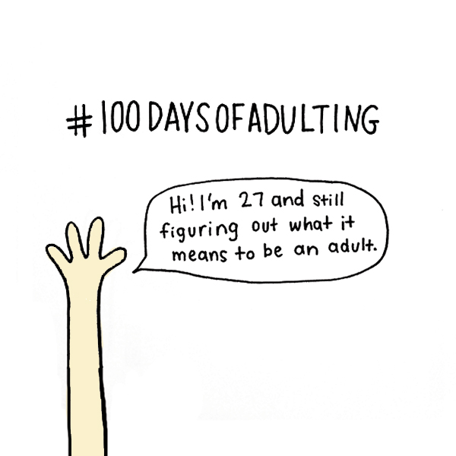
insights
The adulting concept decoded
ADULTING
Feelings
ADULTING
Actions
ADULTING
Purchases
NECESSARY, MUNDANE, IMMEDIATE
Notes:
PHIL
ADULTING
FEELINGS
Imposter – faking having life together
Less confident – plays on confidence
Comparing yourself to others and everyone is doing better than you
ADULTING
ACTIONS
Moving out
Getting insurance quotes
Cleaning your oven
Having a dinner party
ADULTING
PURCHASES
Necessary and mundane
Immediate
ADULTING
PRODUCTS
CONSUMABLE – CLEANING SUPPLIES, LAUNDRY ACCESSORIES, TOILETRIES, PET SUPPLIES
DURABLE – DECORATIVE TOWELS, FAN, WINE GLASSES, VACUUM CLEANER

Slide 20

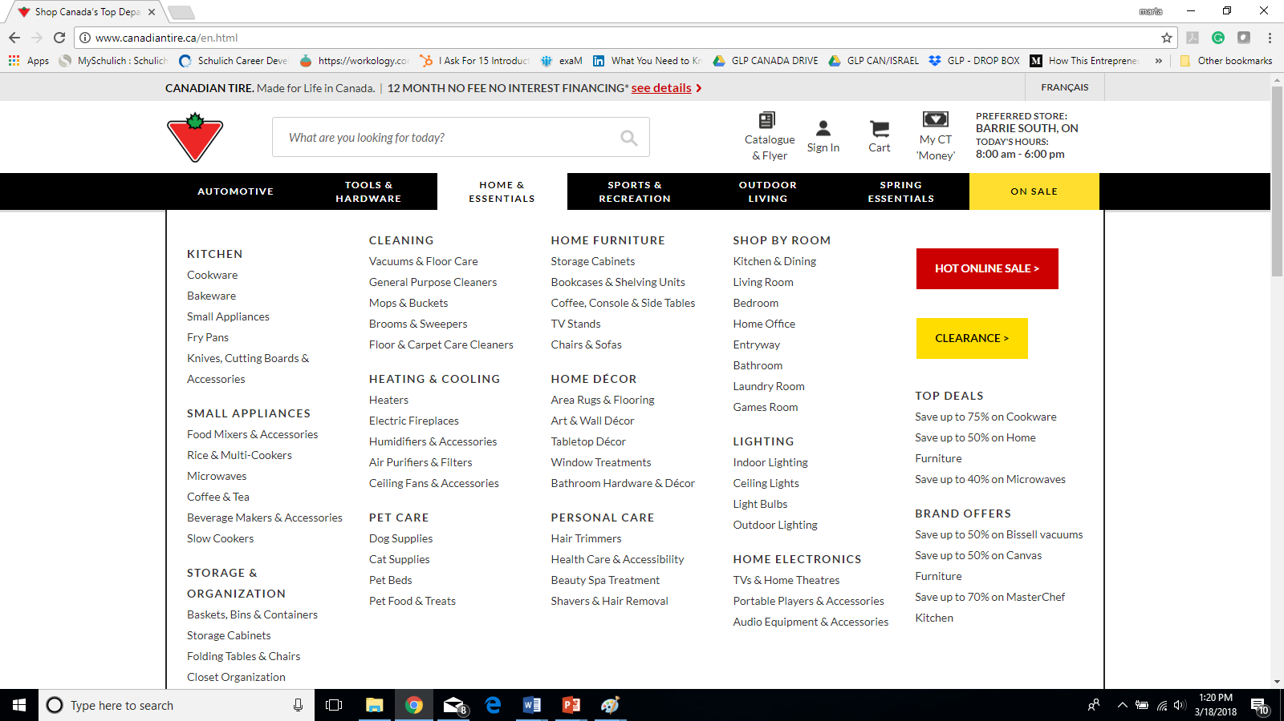
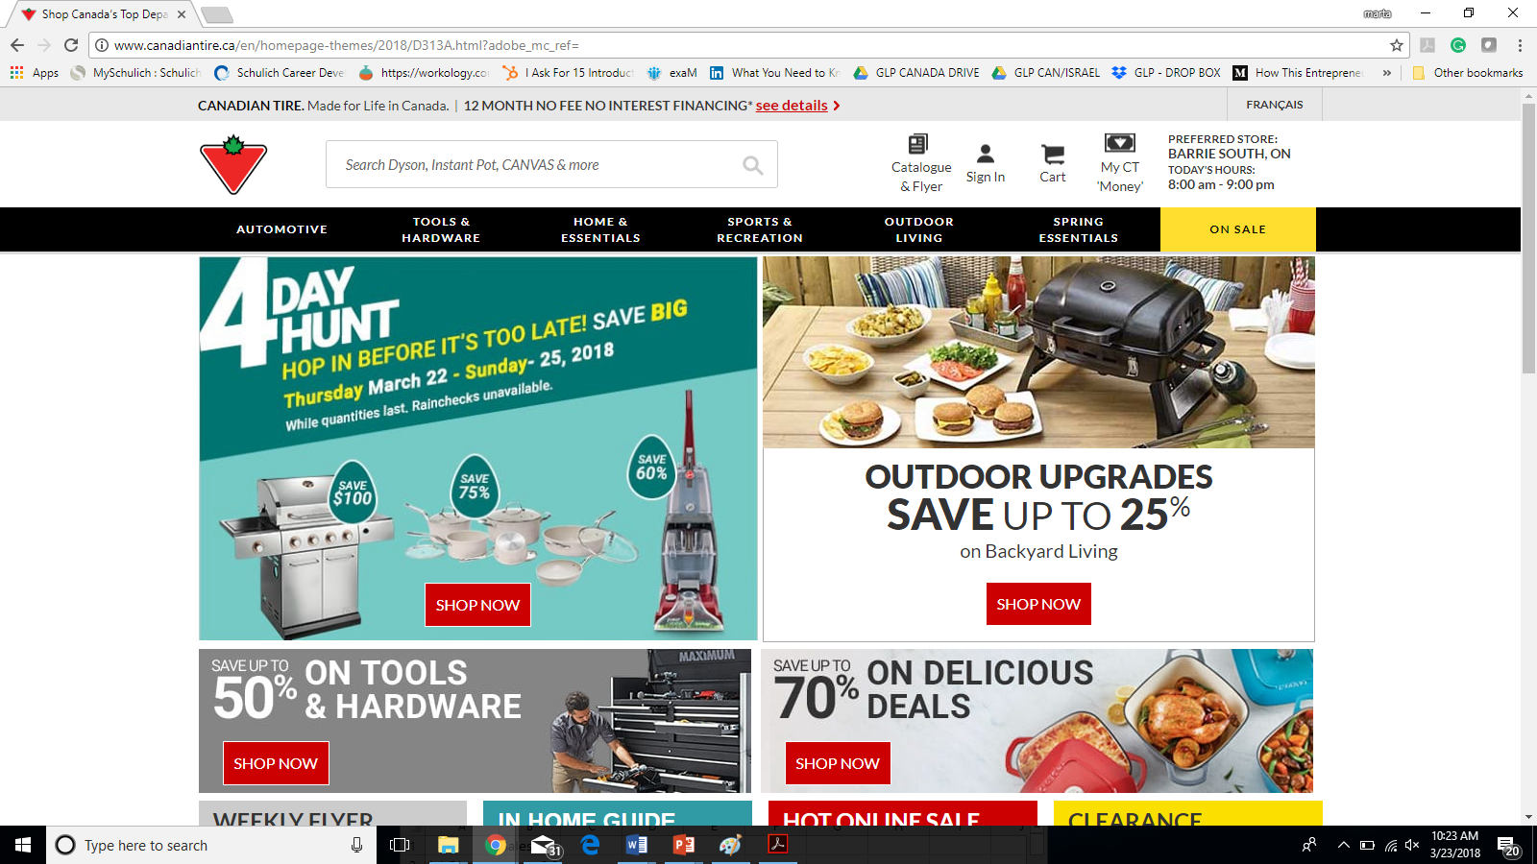
INSIGHTS
Notes:
PHIL

Slide 21
insights
CANADIAN TIRE: perfectly positioned to be the DESTINATION FOR ADULTING
Choice Dimensions | CANADIAN TIRE | AMAZON | WALMART | COSTCO | DOLLARAMA
Proximity to Urban Downtown | x |  |  |  | x
Brick and Mortar (Immediacy) | x |  | x | x | x
Broad Adulting Categories | x | x | x
Entry-Level Price Point | x | x | x | x | x
Mid-Level Price Point | x | x | x | x
Loyalty Program | x | x | x | x
Notes:
CLEAR TRANSLATION
PHIL

Slide 22
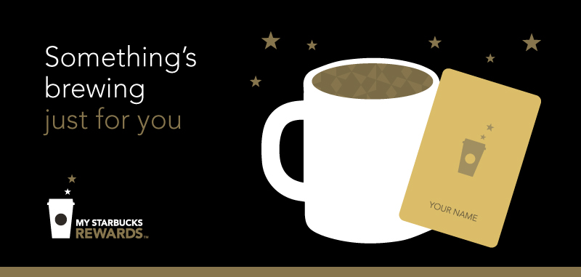


No loyalty programs reward millennials for adulting

Slide 24
INSIGHTS
RECAP
Millennials are adulting
Canadian Tire meets adulting needs
No loyalty program owns adulting space

Slide 25



solution
Make crimson the loyalty program that rewards millennials for adulting and use it to drive ct’s top of mind awareness.
Education through online content
Contest
Create loyalty through app engagement
Notes:
Short term
Vs. Long Term CONTINUED
PHIL

Slide 26
recommendation

Slide 27
Recommendation
Online content strategy
Objectives:

Slide 28
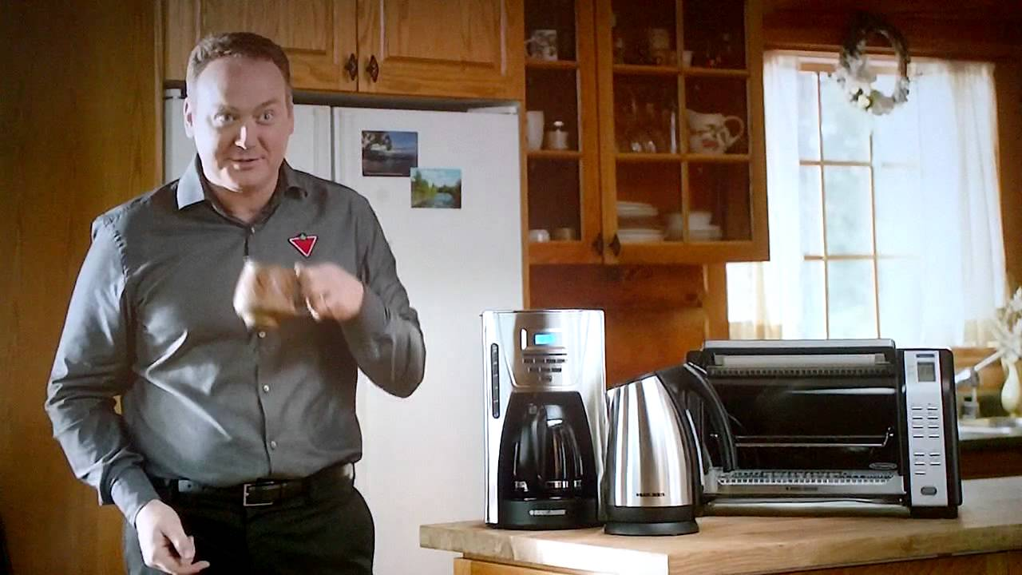

Slide 29
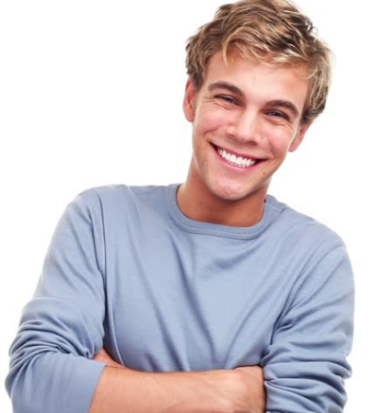
RECOMMENDATION
MEET jerry!
Video Campaign
6 Humorous
2 Informational
Notes:
Meet Jerry, son of Canadian Tire’s Gary!
Watch Jerry navigate his early adulthood while making use of Crimson Rewards in innovative and humorous ways in a series of 8 videos on social media!
Objective: raise awareness about Crimson, and share a laugh!

Slide 30
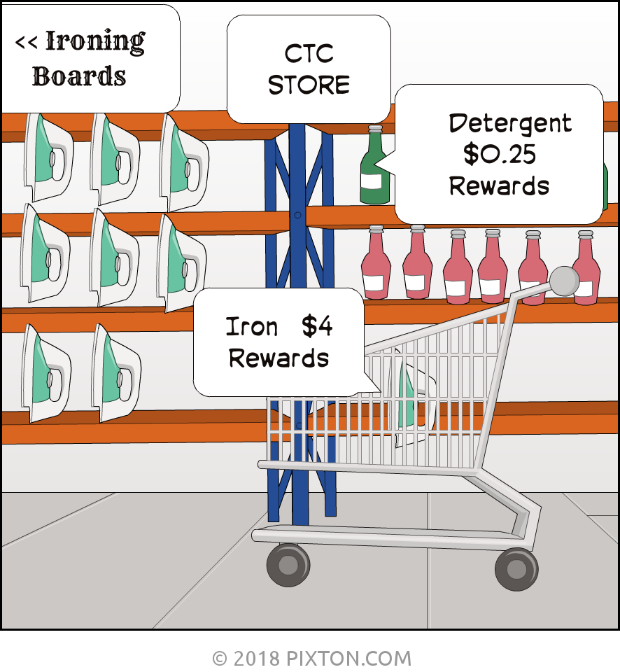
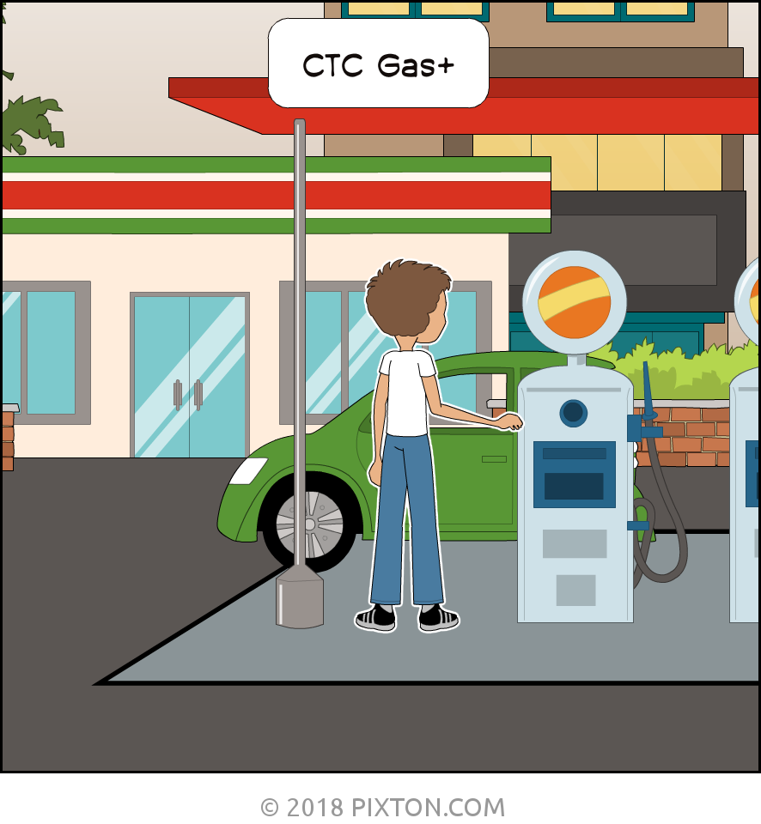
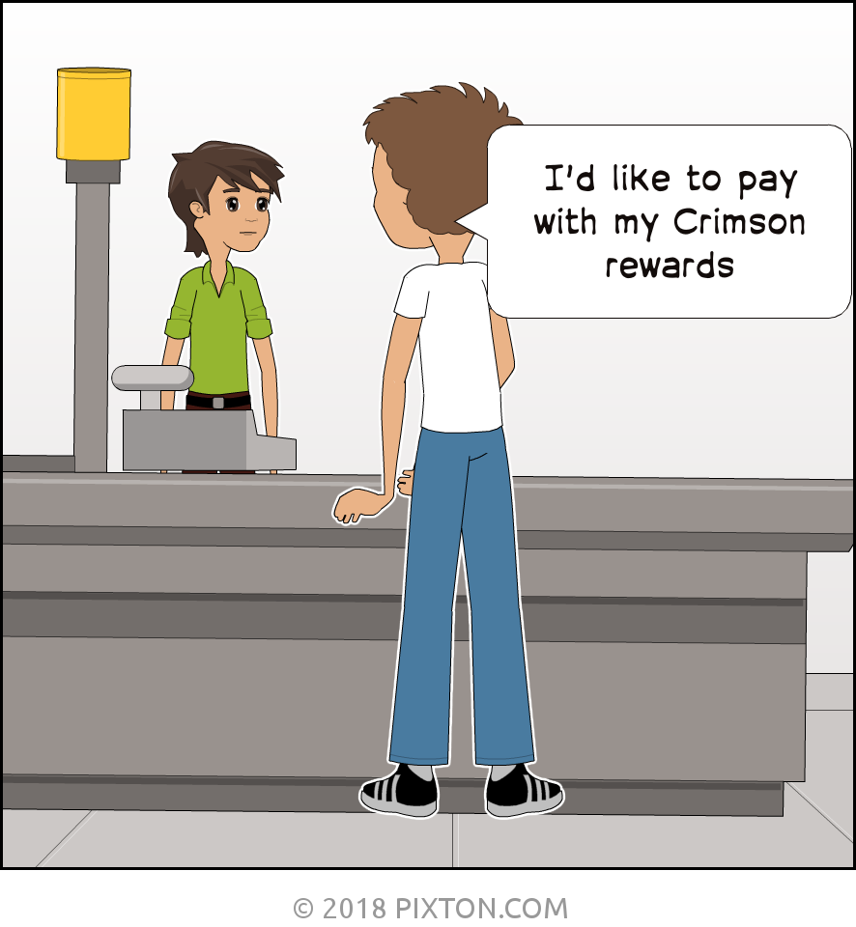
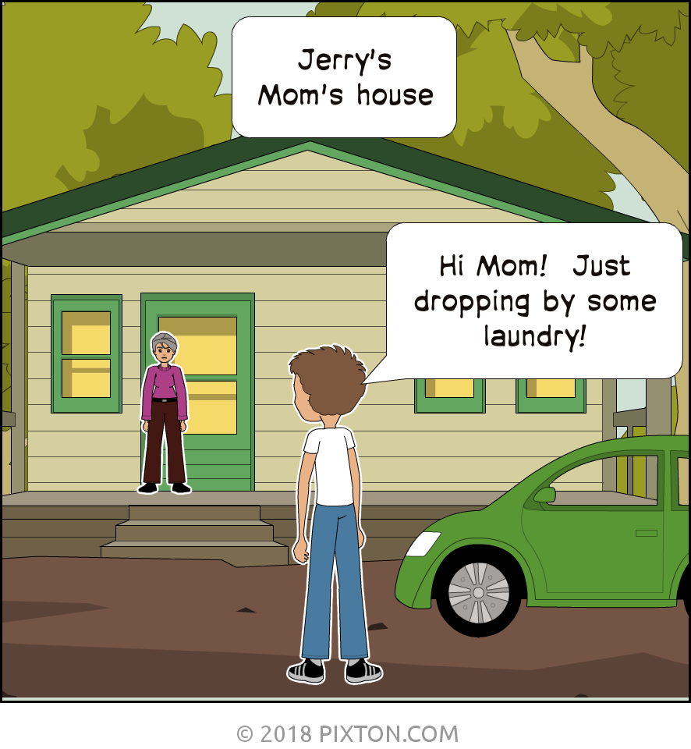
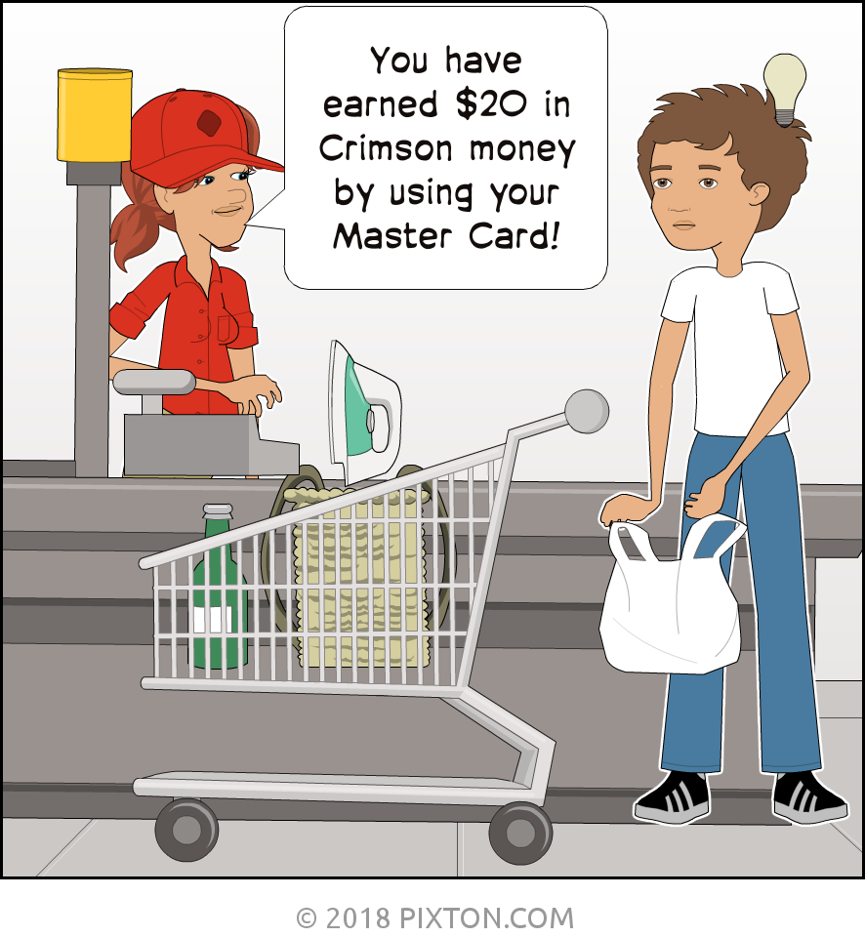
RECOMMENDATION
JERRY DOES LAUNDRY
CRIMSON REWARDS
ADULTING
DONE
RIGHT!
Notes:
MARTA

Slide 31
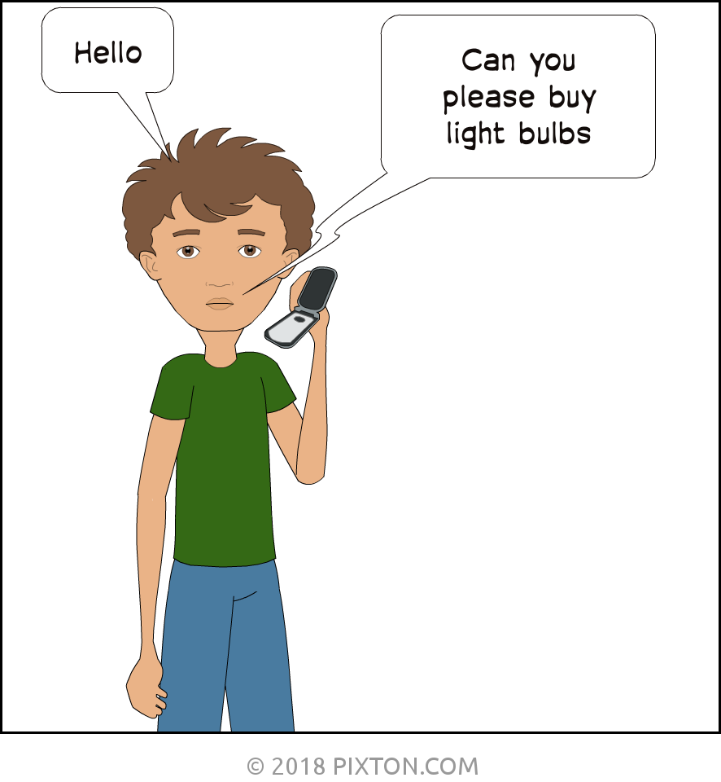

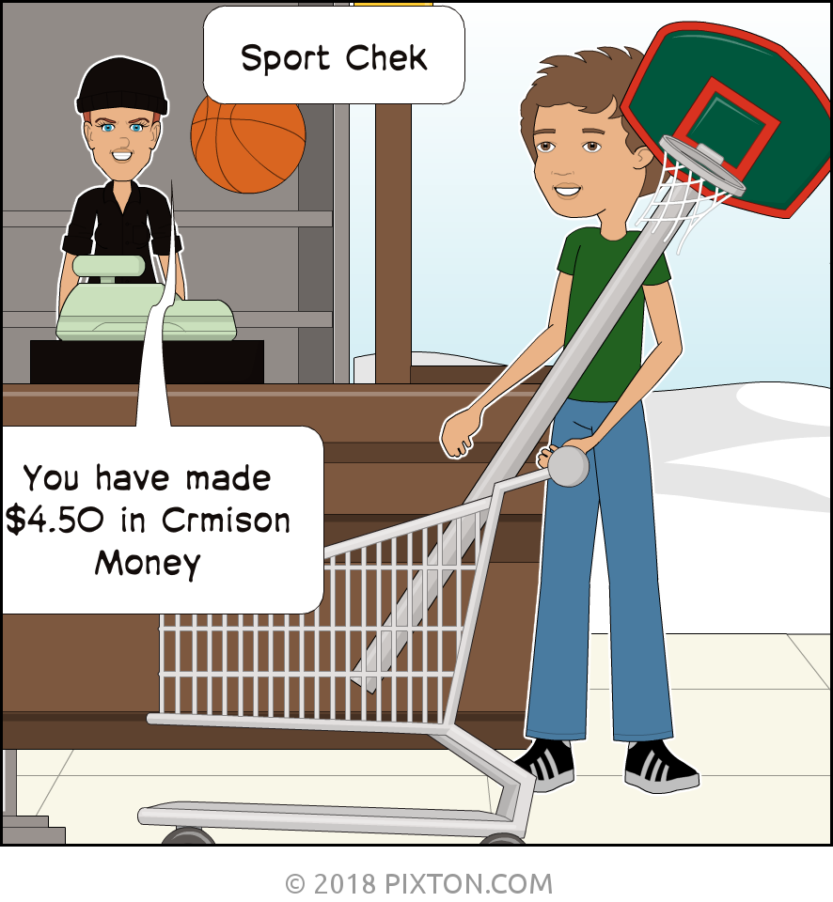
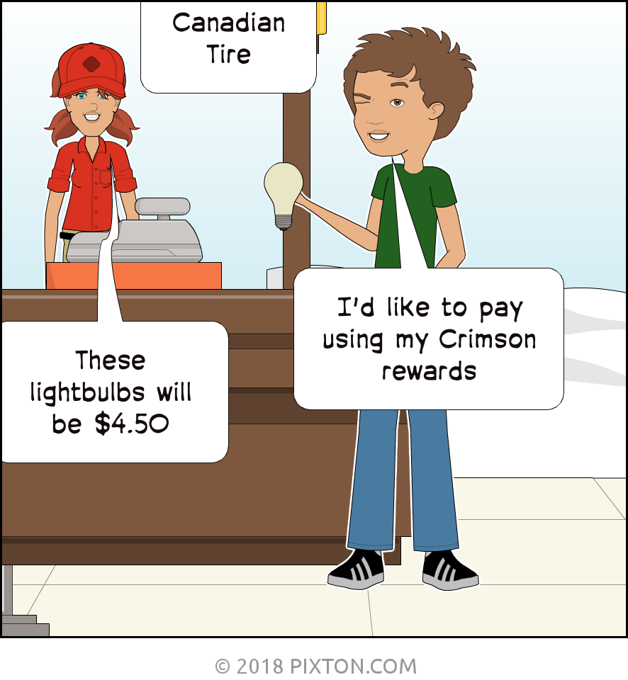
recommendation
jerry buys lightbulbs
CRIMSON REWARDS
ADULTING
DONE
RIGHT!
Notes:
MARTA

Slide 32
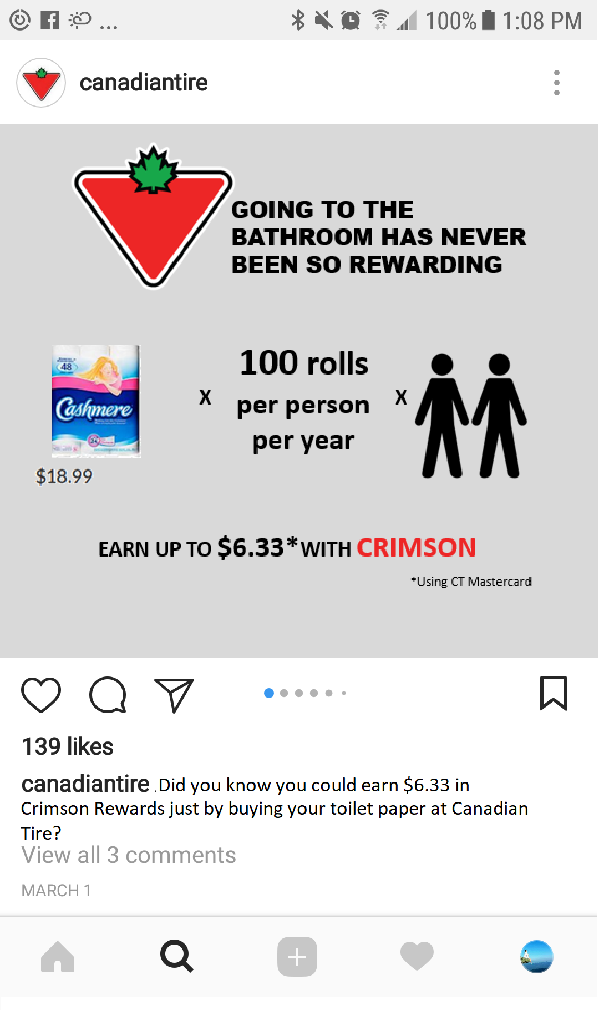
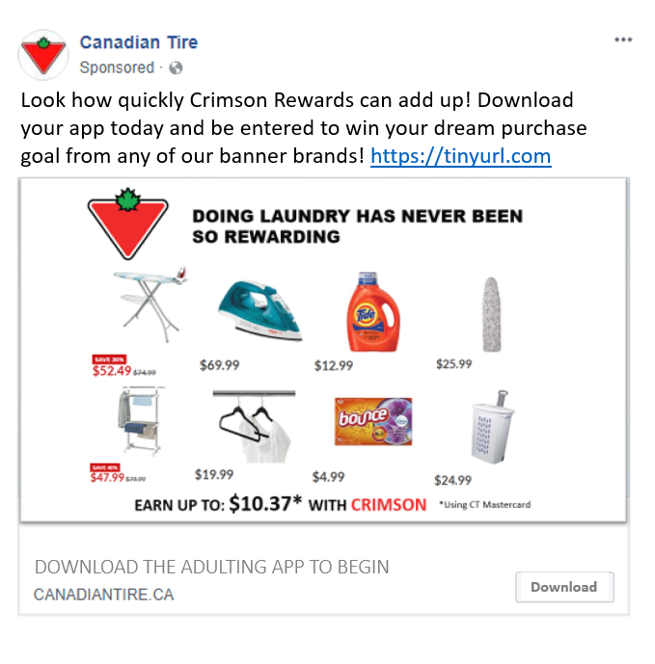



recommendation
Infographic: EDUCATE MILLENIALS BY DEMONSTRATING HOW QUICKLY REWARDS ADD UP
Notes:
MARTA

Slide 33
recommendation
Leverage ct’s traditional channels:
Website, Flyer & catalogue
6 Week Campaign:
Embed application video into FLIPP during 6 week campaign
Create REWARD YOURSELF call-out on physical flyer
Beyond:
Website section tailored to adulting
Destination guide tailored to adulting
Notes:
MARTA
FLYER – ADULTING SECTION
PROMOTIONS – ADULTING
Back-to-school
New Years
May 1 (moving time)
ONLINE FLYER SPECIAL CALL-OUT OF ADULTING VIDEO ETC
FLIPP AP
WEBSITE – adulting category within navigation
SPECIALIZED FLYER
Millennials living at home – that get the flyer
THERE ARE GOING TO BE CONSUMER BASED DECISIONS AND BUSINESS BASED
FLYER – IS IT WORTH
Catalogue
Destination -Home
IMPORTANT BUSINESS NEED – THE FLYER IS VERY IMPORTANT / DRIVER – RIGHT FOR THE BROADER BUSINESS – COMMUNICATE CROSS-CHANNELS – EVEN IF ONLY 10% OF MILLENNIALS WILL LOOK AT THIS THROUGH THE FLYER

Slide 34

CHANNELS

Slide 35






Recommendation
re-marketing content ACROSS PLATFORMS TO INCREASE EXPOSURE
Boost Videos and Infographic
CTC and Adulting
Video embedded in online flyer
Call-to-Action Tweets
Promoted Video
Sponsored Content
Notes:
MARTA
TERM – MEDIA TO SHELF _ 360 HOLISTIC PLAN
MEDIA INTO THE STORE

Slide 36


recommendation
THE HOOK
5%
Risk Free Sign Up (App)
Contest
Sign Up Bonus
Notes:
MARTA

Slide 37

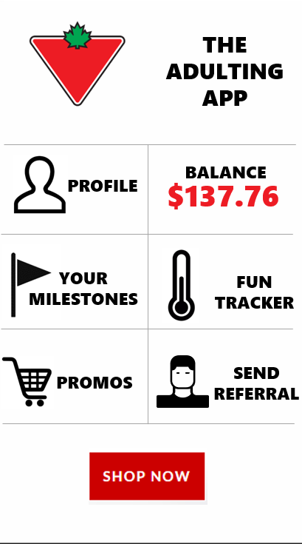

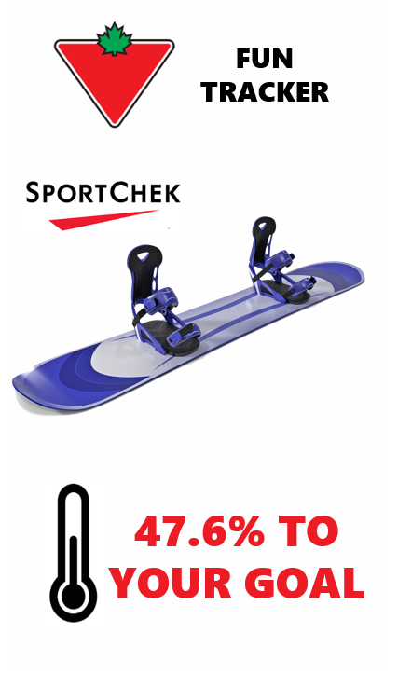


recommendation
THE ADULTING APP WILL AUGMENT CT APP TO TARGET THE MILENNIAL
Track rewards against a product goal from any CTFOC retailer
Update milestones for targeted promotions
Referral program
Seamless link to CT app to browse website
Notes:
MARTA

Slide 38
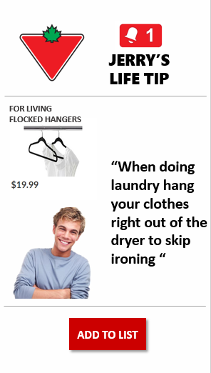
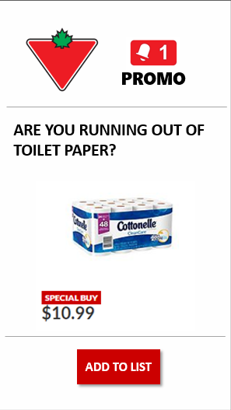
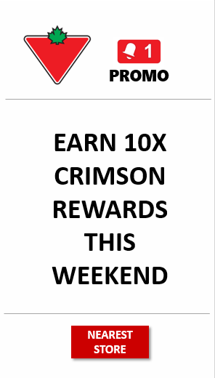
recommendation
CREATING AND REWARDING NEW SHOPPING PATTERNS
Notes:
MARTA

Slide 39


RECOMMENDATION
Customer journey
AWARENESS & EDUCATION
ENGAGEMENT
LOYALTY
Discovered Info on Marketplace App
Targeted Post Infographic
Upload Purchase Goal
Earn 10 x Points on Next Purchase
5%
Watch Video Online
App
Download
Sign Up Bonus
5% Towards App
Product Promo / Recommendation
CT Store Visit
Referral
CT Flyer
Samantha
Proactive Shopper
ADVOCACY
Notes:
FLIPP -
MARTA – ANNIMATE
CONSUMER JOURNEY – ARE THERE TOO MANY STEPS?
LONG – FORM – IF THEY WENT THROUGH ALL OF THE PROCESSES
WHAT IS THE SHORT CONSUMER JOURNEY ?? –
TIME STARVED – AS QUICK AS POSSIBLE

Slide 40
RECOMMENDATION
Customer journey
AWARENESS & EDUCATION
ENGAGEMENT
LOYALTY
Watch Video Online
Targeted Post
Contest
Upload Goal Purchase
Earn 10 x Points on Next Purchase
5%
Targeted Post Infographic
App
Download
Sign Up Bonus
5% for Goal
Product Promo / Recommendation
CT Store Visit
Referral
Run Out
Will
Reactive Shopper
ADVOCACY
Notes:
MARTA - ANNIMATE

Slide 41
impact

Slide 42
impact
Measuring success: kpi objectives
Awareness
Youtube views: 6 million
Facebook views: 3 million
Twitter views: 100,000
Instagram views: 20,000
Awareness
Engagement
Engagement
App Downloads: 187,831
Comments: 75,0000
Upvotes: 90%
Follower growth: 75K Youtube / 55K on Instagram / 180K followers.
Loyalty
Loyalty
Power users: 10% (18,731)
Advocacy
Advocacy
Referrals: 15,000 (3 people each)
Notes:
PHIL
Loyalty
- 10% (18,731) will become power users ,
80% (150,265) will be moderate users 10% (18,835) will abandon the platform. Target low-activity accounts with promotions and incentives
Advocacy
15,000 users referring 3 people to claim $5. Support referrals via in-app tools, track engagement and referral activity to gauge program success.

Slide 43
impact
within 1 year it is expected that the campaign will increase revenue by $9M at Canadian Tire
Total Marketing Spend | 1,500,000
Target Millennial Cohort (24-35) | 3,672,659
Current CTC money members (in target demo) | 1,204,426
Canadian Tire Market share | 5.10%
Number of App downloads/Sign-ups | 187,306
Regular Crimson users (10%) | 18,731
Moderate Crimson Users (80%) | 149,845
Abandoned (10%) | 18,730
Cost per acquisition | $8
ROI | Worst Case | Medium case | Best Case
Power users | 12500 | 18731 | 22000
Average Expenditure | $ 44.00 | $ 54.00 | $ 64.00
Annual Visits | 6.0 | 9.0 | 12
Expected Revenue | $ 3,300,000.00 | $9,103,266 | $ 16,896,000
Notes:
PHIL
Campaign roi
QUANTIFIED TANGIBLE NUMBERS – SHORT TERM VS LONG TERM – MOVE INTO HIGHER DISPOSABLE INCOME AND CONTINUE TO PURCHASE PRODUCTS FROM CTC
WHAT IS THE ROI FOR THE CONSUMER
FRANCHISE – ITSELF
INTERNALLY FOR CTC – STRATEGIC LIFECYCLE OF CONSUMER – NOT AGED IN AND NOT BEING ABLE TO CATCH – LIFETIME LOYALISTS

Slide 44
IMPACT
In the long term the campaign will increase the lifetime value of an average Canadian customer by capturing loyalists earlier
0
25
50
75
Active Years:
28
Life Time Value
$9072
AGE
CURRENT STATE
Δ 12 years
Δ $3888
0
25
50
75
Active Years:
40
Life Time Value:
$12960
AGE
FUTURE
STATE
Cohort is being squished
  CTC is not in consideration set until you own a house with a backyard, garage, and have kids are hockey.
PRIMARY RESEARCH ON CTC (interviews) ‘quote’
“Canadian tire is where you get things for your home, like alarms and fixtures and car batteries.”
“I guess with everyday things, I don’t think about Canadian Tire, like it is easy to get with groceries or stop at a dollar store. I guess Canadian Tire is where my dad sharpened my skates and bought a ceiling fan, you know?”
Notes:
PHIL
BY BUILDING LONG TERM LOYALTISTS/ BUILDING LOYALTY EARLIER
Assumption:
Current loyal customer – 6 x per year – 37-65 - $54/ purchase
Future loyal customer – 6 x per year – 25-65 - $54 / purchase

Slide 45
Implementation

Slide 46
CAMPAIGN
GO LIVE:
AUGUST 16, 2018
TACTICS
01
WEEK 1 – August 16 – August 2
2 Videos Launch – Humorous & App
2 x Infographic
Contest LAUNCH
Video in Flipp Flyer
02
WEEK 2 – August 23 – August 29
2 x Videos Launch – Humorous & App
2 x Infographic
2 x Contest Winners
Video in Flipp Flyer
03
WEEK 3 – August 30 – September 5
1 x Videos Launch – Humorous
2 x Infographic
2 x Contest Winner
Video in Flipp Flyer
04
WEEK 4 – September 6 – September 12
1 x Videos Launch – Humorous
2 x Infographic
2 x Contest Winner
Video in Flipp Flyer
05
WEEK 5 – September 13 – September 19
1 x Videos Launch – Humorous
2 x Infographic
2 x Contest Winner
Video in Flipp Flyer
06
WEEK 6 – September 20 – September 26
1 x Videos Launch – Humorous
2 x Infographic
2 x Contest Winner
Video in Flipp Flyer
Notes:
PHIL

Slide 47
implementation
High level schedule – 28 WEEKS
WEEK | 1 | 2 | 3 | 4 | 5 | 6 | 7 | 8 | 9 | 10 | 11 | 12 | 13 | 14 | 15 | 16 | 17 | 18 | 19 | 20 | 21 | 22 | 23 | 24 | 25 | 26 | 27 | 28
PROJECT BRIEF |  |  |  |  |  |  |  |  |  |  |  |  |  |  |  |  |  |  |  | CAMPAIGN GO LIVE – AUGUST 16
APP DEVELOPMENT
APP TESTING
VIDEO CREATION
INFORGRAPHIC CREATION
CAMPAIGN
POST MORTEM
TARGETTED GO LIVE: THURSDAY AUGUST 16, 2018
Notes:
PHIL
BRIEF – 2-3 WEEKS
PRE-LAUNCH
CHART – TARGETED GO LIVE! – INFORMED DATE OF LAUNCH
RESET FOR ADULTS
RESOURCES _AGENCY _ INTERNAL APPROVAL_TASK FORCE_APP DEVELOPER
SUCCESS METRICS OF IMPLEMENTATION –
RANDOM – LAUNCHING – ARE THERE ANY TARGETED DATES FOR PROMOTED POSTS – QUEBEC – ST. JEAN BAPTISTE DAY WHEN EVERYONE MOVES – RENTS RENEW – EVENT_COOL POP UP ON MAKING MOVING EASY_PROMOTING POSTS_LIVE AND
EXCITING BLITZ

Slide 48
implementation
Budget breakdown
Expenses | Total | Percent | Percent of Total
Video Creation | $300,000.00 | 20.00% | 20.0%
Facebook Advertising | $225,000.00 | 15.00% | 35.0%
In-Application Giveaways | $130,000.00 | 8.67% | 43.7%
YouTube Advertising | $125,000.00 | 8.33% | 52.0%
Adwords | $100,000.00 | 6.67% | 58.7%
Twitter Advertising | $100,000.00 | 6.67% | 65.3%
Instagram Advertising | $100,000.00 | 6.67% | 72.0%
Adulting App | $100,000.00 | 6.67% | 78.7%
Referrals | $100,000.00 | 6.67% | 85.3%
In-store Promo Material | $75,000.00 | 5.00% | 90.3%
Flipp embedded content | $75,000.00 | 5.00% | 95.3%
Adulting Contest Giveaways | $50,000.00 | 3.33% | 98.7%
Content creation (E.g. infographics) | $20,000.00 | 1.33% | 100.0%
Total | $1,500,000.00 | 100.00%
Notes:
Content Creation – 420,000
Social Ads - $725,000
Loyalty and Rewards – 280
In-store promo - 75

Slide 49
implementation
Performance will be monitored, and budget re-allocated within social advertising
VIDEO TRENDING
SENTIMENT ANALYSIS
KEYWORD MONITORING
AUDIENCE ENGAGEMENT
Notes:
RECOMMENDATION WILL MONITOR PERFORMANCE THRUOGH
EARLY WARNING BELLS – MONITOR THROUGH THESE ANALYTICS TO DRIVE BUDGET EFFICENCIES
PHIL

Slide 50
implementation
Post-campaign, adulting blitzes should continue on the following dates:
July 1st, Moving Day (Quebec)
September 1st, Labour Day/Back-to-School (ROC)
October 10th, start of holiday parties
January 7th, New Years Resolutions
May 1st, Moving/Summer
!
Notes:
PHIL

Slide 51
recap

Slide 52
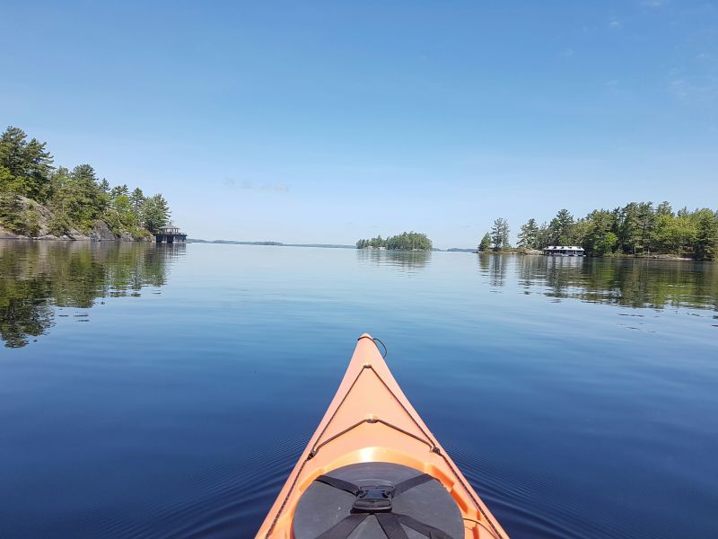
Notes:
PHIL
CREATE HEADLINES – ON EACH SLIDE -

Slide 53
CRIMSON REWARDS
ADULTING
DONE
RIGHT

Slide 54
APPENDIX

Slide 55

Appendix
Created in 2018 with merger of PC Plus and Optimum programs
Can collect and redeem at over 2,500 locations:
  Loblaws banners
  Shoppers
  Esso
Over 10 million users
Numerous data breaches has pulled the program down

Slide 56

Appendix
Owned and operated by Toronto-based LoyaltyOne
Currently has 10 million members
Can be redeemed at numerous companies across Canada:
  Metro
  Rexall
  Rona
  Bank of Montreal
  American Express
  Amazon
Large OTA associated with Air Miles

Slide 57
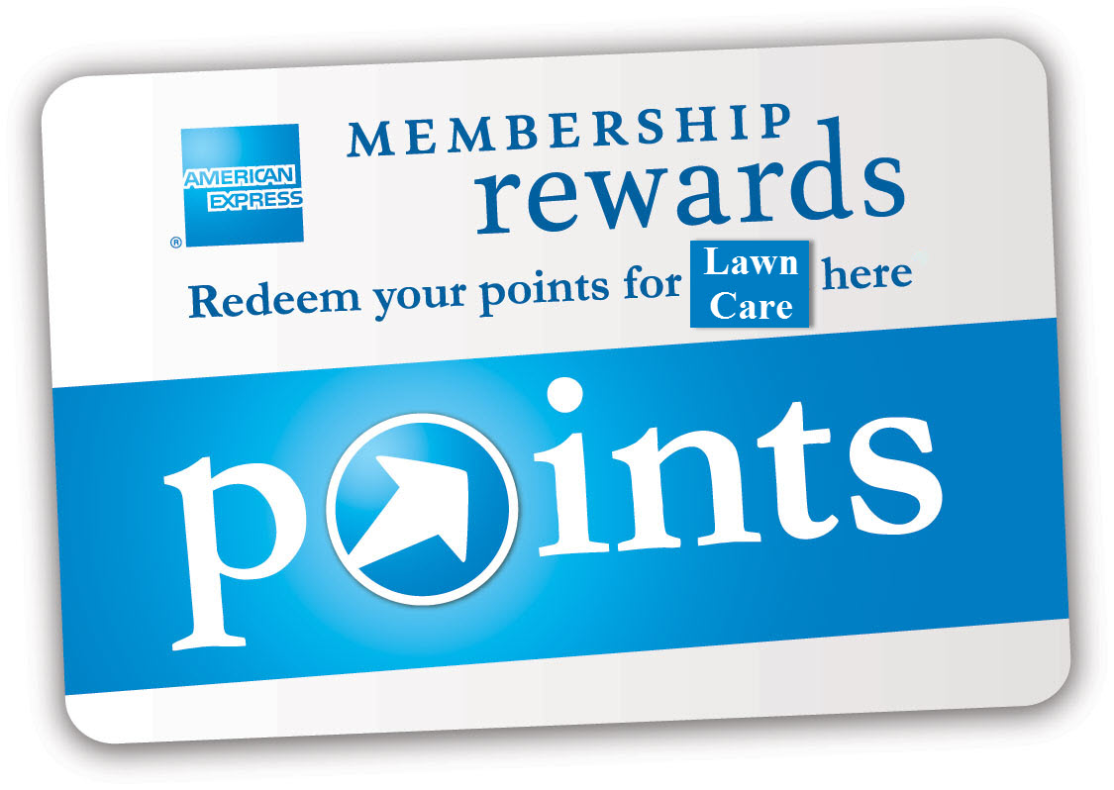
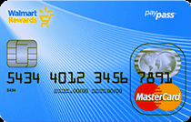
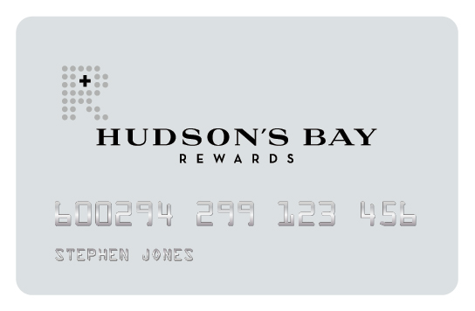
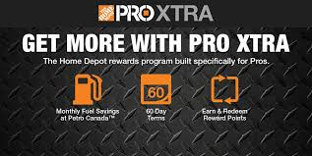
Appendix
Fewer than 10 million active users
Associated with credit cards or corporate accounts
Lack flexibility to accrue points compared to PC or Air Miles
More limited range of options when spending points
Notes:
HBC rewards can work in conjunction with RBC or Petro-Canada but you already need to be a loyalty rewards member of each to benefit from HBC Rewards

Slide 58

Appendix
45 billion in revenue
2,500 stores
Concerns over possible expansion of Kroger’s has led Loblaws to increase space for apparel and homewares to 1/3rd
Focused on groceries and household items, such as cleaning supplies
Limited growth opportunities, low margins, high costs, possible
> 30,000 SKUs

Slide 59

Appendix
391 stores
8.4 million weekly visits in-store
Launching new home delivery
Decreasing number discount stores/increasing number of supercenters
Roughly 60 million square feet
Market share has doubled in 10 years
Fewer private label brands than competition

Slide 60

Appendix
Membership/subscription based
Only large format
Currently has about 10 million active users
4,000 SKUs
Exclusively sells Kirkland brand
98 stores in Canada

Slide 61
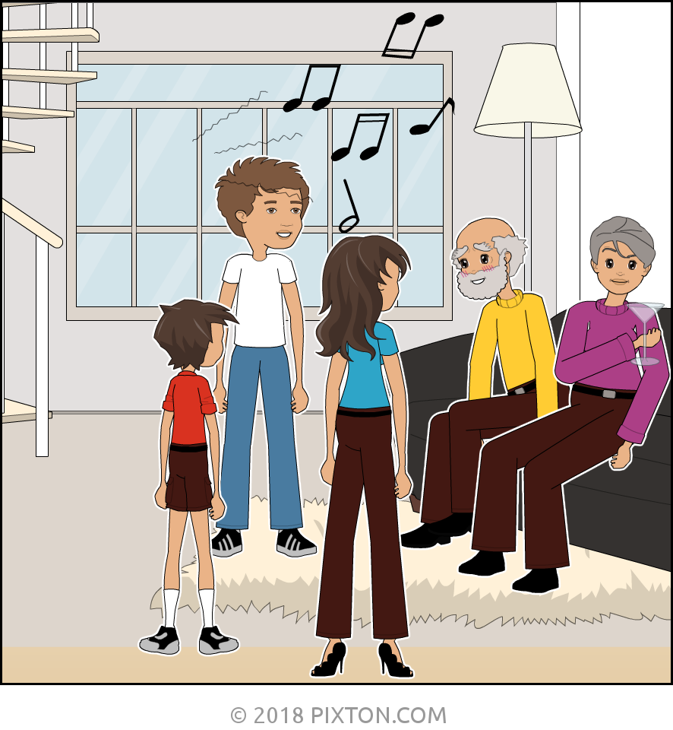
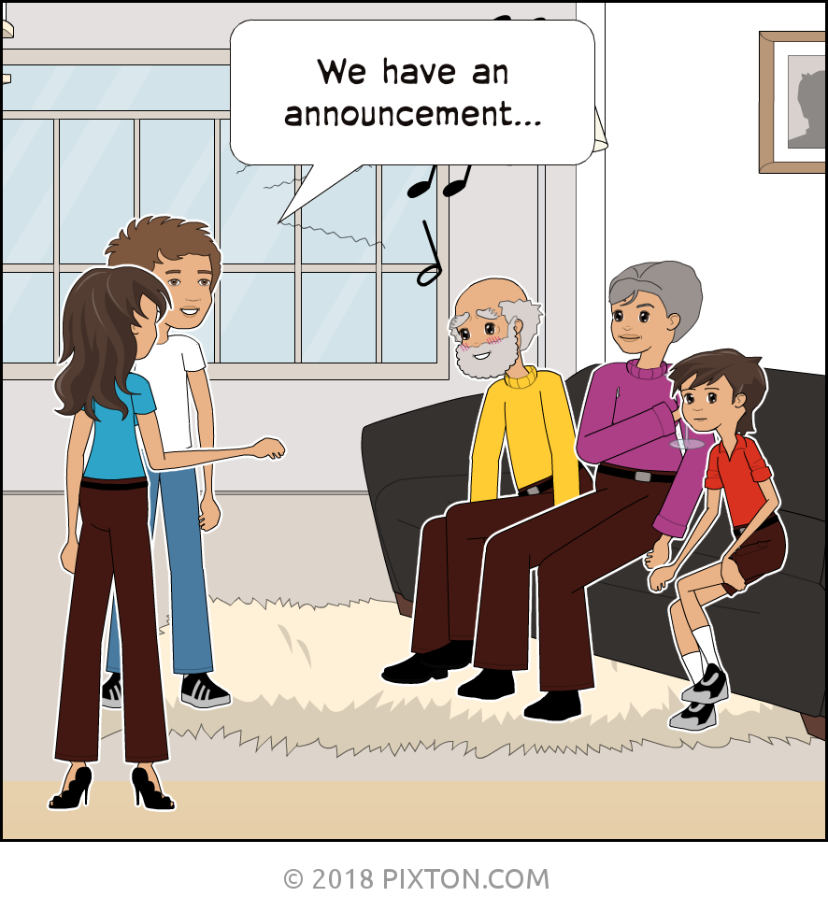
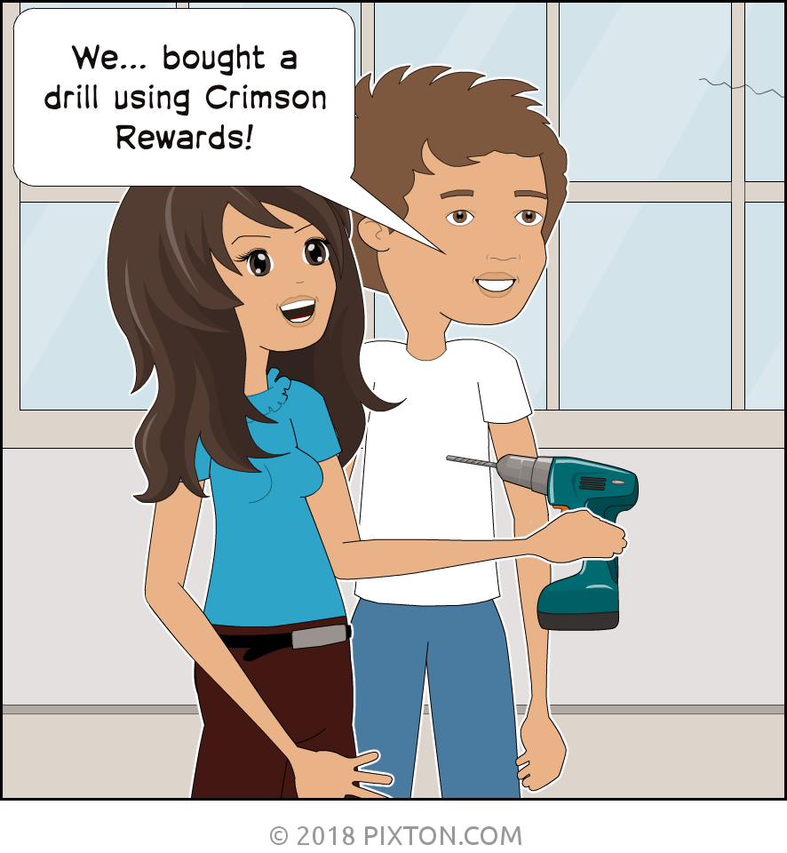
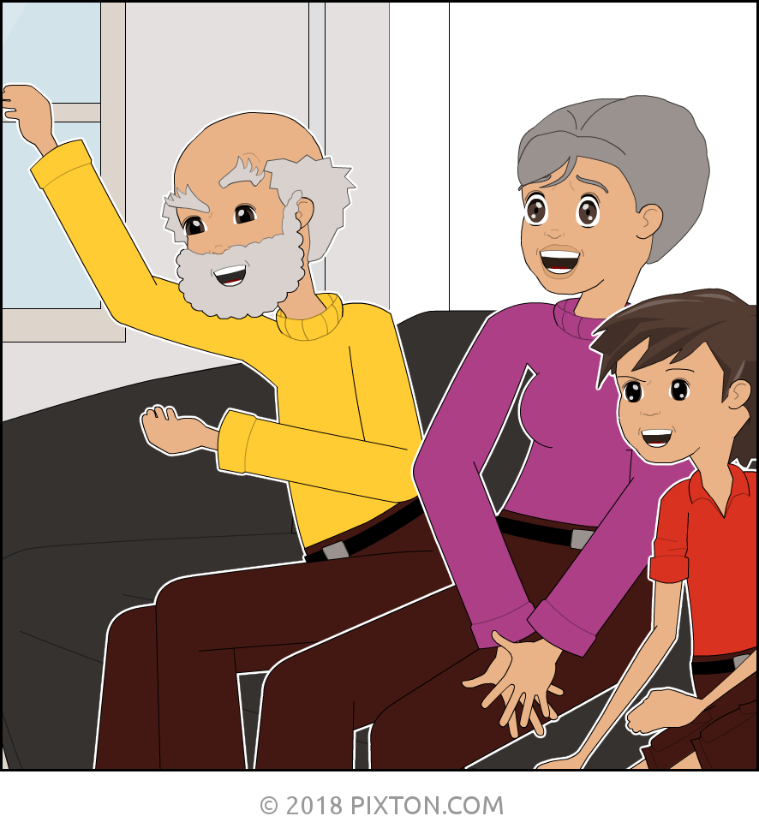
recommendation
Video: jerry’s announcement
CRIMSON REWARD YOURSELF
Scene 1
Scene 2
Scene 3
Scene 4
Scene 5
Wide shot of family gathering.
Jerry and his girlfriend get up in front of the family. The hold hands and look excited, Everyone is expecting a big announcement.
Close up shot of couple.
Jerry says, “We are so excited to announce that we [pause] used our Crimson rewards to buy a drill!”
Family starts clapping.
Notes:
MARTA

Slide 62
RECOMMENDATION
Video: JERRY DOES LAUNDRY
CRIMSON REWARD YOURSELF!
Scene 1
Scene 2
Scene 3
Scene 4
Scene 5
Scene 6
Close up shot as items from laundry aisle added to cart at Canadian Tire (with Crimson rewards lighting up)
Jerry is checking out. Pays with Crimson Affinity Card. Learns he has made $20 in Crimson rewards through a promotion.
Jerry has an idea.
Long shot of Canadian Tire gas bar.
Close-up of Jerry checking out. Pays his gas using Crimson rewards he earned moments ago at Canadian Tire.
Jerry pulls up to Mom’s house. Mom looks surprised.
Jerry greets her and says, “Hi Mom, just thought I’d stop by for dinner. Can you also do my laundry?”
Notes:
MARTA

Slide 63
recommendation
Video: jerry buys lightbulbs
CRIMSON REWARD YOURSELF!
Scene 1
Scene 2
Scene 3
Scene 4
Scene 5
Shot of Jerry on the phone. Girlfriend asks him to buy lightbulbs.
Jerry has an idea.
Jerry goes to Sport Chek and buys a basketball net.
The amount of Crimson Rewards earned appears on the screen.
Jerry is at Canadian Tire checking out with lightbulbs The total comes to exactly what he earned at Sport Chek. Pays with Crimson and looks very happy with himself.
Notes:
MARTA

